Slide 1
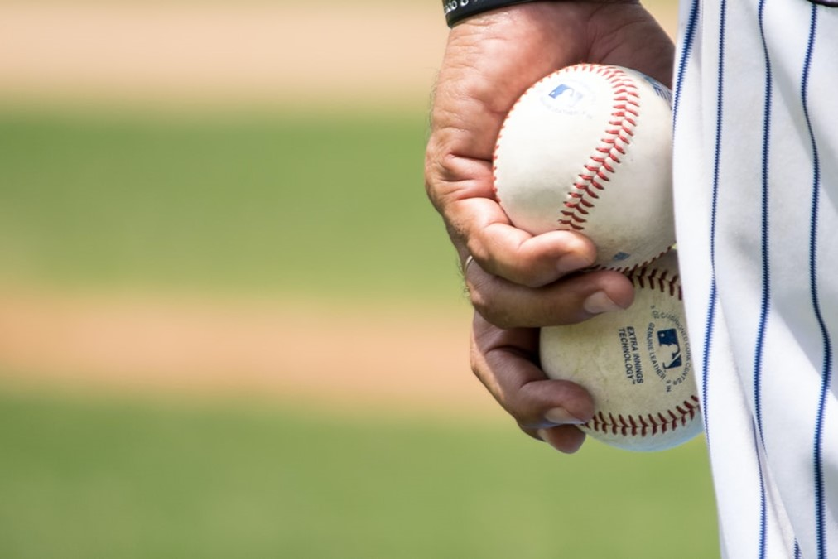
The Effect of the Pitch Clock on MLB Pitchers
Diana Bergeman
Eric Droegemeier
Gregory Ehlinger
Triniti Lemmons
Mauricio Sanchez
Notes:
GREGORY
SO LET’S PLAY BALL!

Slide 2
Background
MLB founded in late 1800s
Average MLB game length: 3 hours
Pitch clock implemented in 2023 season
Notes:
TRINITI
Major League Baseball was founded in the late 1800s and is the United States’ oldest professional sports league
Every season from 2016 to 2022, the average MLB game length was a minimum of 3 hours long
As games progressively increased in length, many fans began to complain that games were too long.
To combat this, starting during the 2023 season, the MLB has implemented a new pitch clock system with the goal of shortening game length.
So the way that the pitch clock works is, following the conclusion of the previous play, this new timer gives pitchers 15 seconds to pitch the ball in the event that there are no batters on any of the bases. If there is a batter on base, then the pitcher is given 20 seconds to pitch the ball. If the pitcher doesn’t release the ball prior to the pitch clock expiring, then the pitch automatically is counted as a ball, which is in the favor of the batting team

Slide 3
Purpose Statement
Does the MLB pitch clock impact pitcher performance?
Notes:
TRINITI
The goal of our analysis is to answer the question: Does the MLB pitch clock impact pitcher performance?
If the pitch clock hinders the abilities of pitchers to play to their full potential, then there is a chance the MLB may have to re-evaluate the pitch clock’s effectiveness at enhancing the game experience for all players, coaching staff, and spectators.

Slide 4
Variables
Violations: Number of times the pitch clock was violated. Results in an automatic ball
Pace(pi): average time in seconds a specific pitcher spent between pitches
ERA: Average of earned runs a pitcher allowed.
BB%: Percentage of plate appearances that resulted in the batter being walked
K%: Percentage of plate appearances that resulted in the batter being struck out
Pitches: Total pitches thrown
Balls: Total balls thrown
Strikes: Total strikes thrown
HR/9: Number of Home Runs allowed per 9 innings pitched
FIP: Fielder Independent Pitching is a version of ERA that eliminates defense
ERA-: ERA above or below league average where average is 100. Lower is better.
Notes:
DIANA
Our 2022 data consists of pitch statistics of 347 qualifying pitchers (or a pitcher that is eligible for season awards). The average number of pitches for 2022 was 1,584.66. The standard deviation for Pitches is 714.24 which indicates a high level of variability in the data. Other key variables, such as Balls, had a mean of 559.71 and Strikes had a mean of 1,024.94.
For 2023, we reviewed the same key variables, but also included the new variable, Timer Violations, to reflect the rule that was implemented for the 2023 season. The central tendency of the 2023 data for Timer Violations is .699 and for Pitches is 528.61, while Balls is 191.23 and Strikes is 337.37. For the 2023 data, we see low variability with Timer Violations, but higher variability for Pitches.
Overall, the 2023 data variables are positively skewed, however Pace(pi) and Stuff+ are negatively skewed, so they have outliers further towards the left and closer to the mean on the right.

Slide 5
Observations
Data encompasses all of 2022 season and data for 2023 season through July 8th:
708,539 pitches thrown in 2022 season
413,067 pitches in 2023 season as of July 8th
Pitchers with the most pitch violations:
Craig Kimbrel Relief Pitcher (11)
Anthony Bass Relief Pitcher (9)
Joe Musgrove Starter (6)
Josiah Gray Starter (6)
Mychal Givens Relief Pitcher (6)
Kevin Ginkel Relief Pitcher (6)
Notes:
Eric

Slide 6
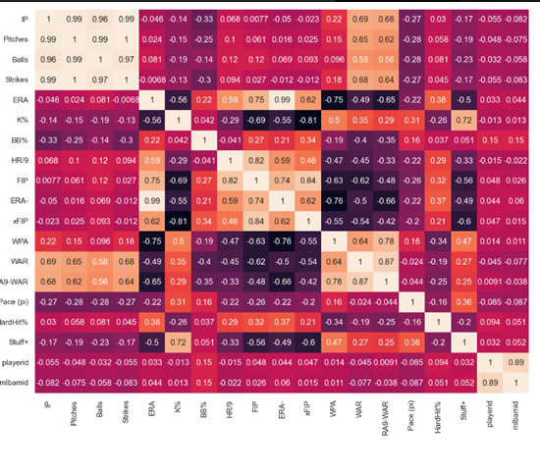
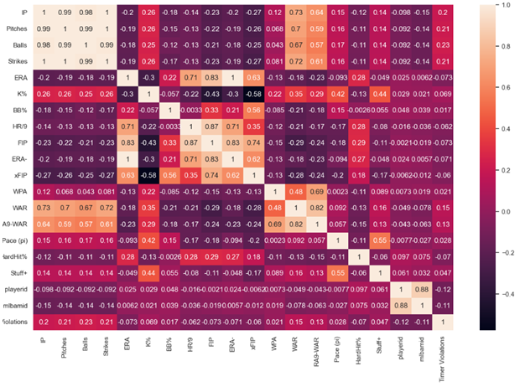
2022
2023
Notes:
DIANA
Comparing the correlation from the 2022 data to the 2023 data we see little change in the key variables.

Slide 7
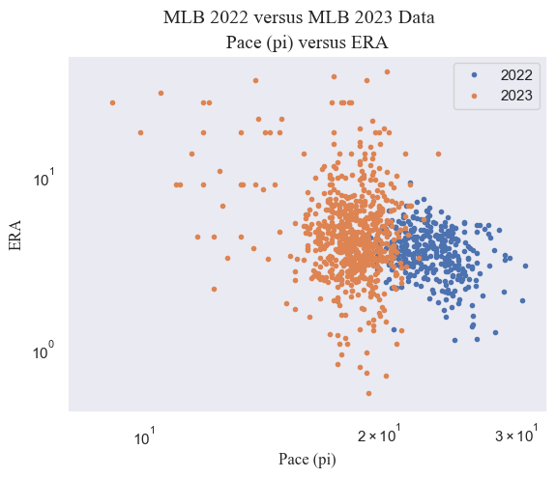
Data Visualization
Plots were created in Python using the matplotlib library.
Variables were chosen carefully by analyzing the heat maps and observing which variables had a high correlation value
Plots showcase the relationship between different variables and compare the 2022 data with the 2023 data
The image above showcases the relationship between Pace(Pi) and the ERA in 2022 and 2023.
Notes:
MAURICIO
Plots were created in Python using the matplotlib library. Variables were chosen carefully by analyzing the heat maps and observing which variables had a high correlation value. Plots showcase the relationship between different variables and compare the 2022 data with the 2023 data.

Slide 8
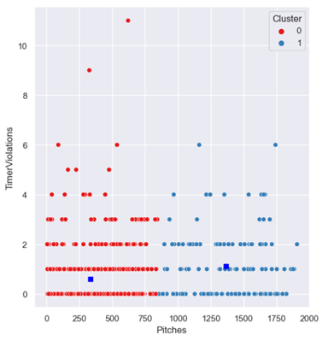
KNN
Using the Elbow Rule and Silhouette Score determined that the ideal number of clusters to use was 2
Cluster 0 (Red)’s cluster center is
300 pitches
0.85 Timer Violations
Cluster 1 (Blue)’s cluster center is:
1375 pitches thrown
1.10 timer violations
Notes:
GREGORY

Slide 9
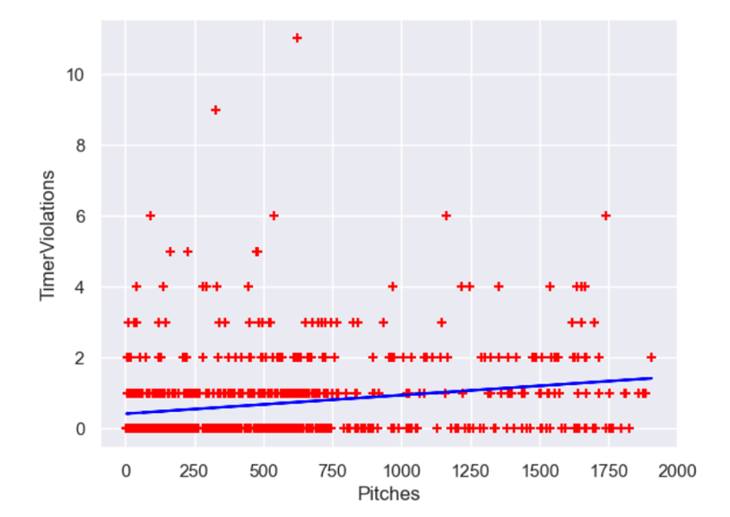
Linear Regression
Two variable Linear Regression Model
Data used: 2023 MLB Season Data
Model Predicts 306.072 timer violations over the span of the 2022 season
R-Squared Value of 0.11500
All Variable Linear Regression Model
No correlation
R-squared Value of 0.00075
Key Variable Linear Regression Model
No correlation
R-Squared Value of 0.04055
Timer Violations = 0.477 + 0.00043 x Pitches
Notes:
GREGORY
When evaluating pitchers, many analysts look for IP, ERA, K%, BB%, xFIP, and WAR

Slide 10
Evaluation & Discussion
No statistically significant correlation between pitcher performance and timer violations
This is a positive result for MLB!!
Shorter games
Increased viewership
Potential for future research:
Include data from spring training
Did the number of violations increase or decrease over time?
Did the timer lead to an increase in injuries?
Notes:
Eric
When evaluating pitchers, many analysts look for IP, ERA, K%, BB%, xFIP, and WAR
Presentation:
No statistically significant correlation between pitcher performance and timer violations
This is a positive result for MLB!!
Games are shorter with no negative impact on player performance
Viewership has increased due to faster games

Slide 11
CONCLUSION
Overall, the pitch clock has been a success for MLB
Goals achieved:
Faster games
More stolen bases
No decline in pitcher performance
Viewership is improving
Notes:
Eric

Slide 12
Thank you!

